Slide 1
BIG DATA WITH HADOOP

Slide 2
CONTENTS
Introduction to BigData
Characteristics of BigData
Applications of BigData
Hadoop
Introduction
Hadoop cluster
Hadoop Ecosystem
Hadoop Tools
Uses of Hadoop

Slide 3
INTRODUCTION TO BIGDATA
Big data usually includes data sets with sizes beyond the ability of commonly used software tools to capture, curate, manage, and process data within a tolerable elapsed time.
Big data "size" is a constantly moving target, as of 2012 ranging from a few dozen terabytes to many petabytes of data.
Big data is a set of techniques and technologies that require new forms of integration to uncover large hidden values from large datasets that are diverse, complex, and of a massive scale.

Slide 4
CHARACTERISTICS OF BIGDATA
BigData is described in 4V’s they are as follows:
1.Volume – It is the size of the data which determines the value and potential of the data under consideration and whether it can actually be considered Big Data or not.
2.Variety - This means that the category to which Big Data belongs to different types of data is also a very essential fact that needs to be known by the data analysts.
3.Velocity - The term ‘velocity’ in the context refers how fast the data is generated and processed to meet the demands and the challenges which lie ahead in the path of growth and development.
4.Veracity - The quality of the data being captured can vary greatly. Accuracy of analysis depends on the veracity of the source data.

Slide 5
APPLICATIONS OF BIGDATA
1. Media Internet of Things (IoT):
Targeting of consumers (for advertising by marketers)
Data Capture
2.Technology:
Facebook handles 50 billion photos from its user base.
As of August 2012, Google was handling roughly 100 billion searches per month.
3. Retail :
Walmart handles more than 1 million customer transactions every hour, which are imported into databases estimated to contain more than 2.5 petabytes (2560 terabytes) of data.

Slide 6
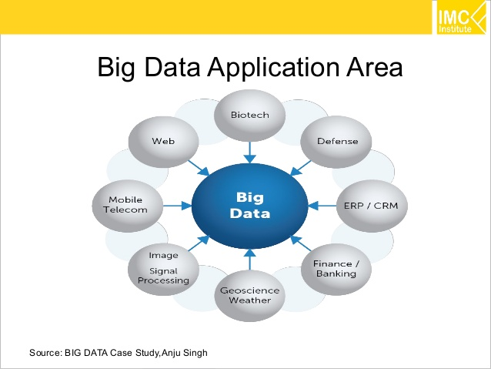

Slide 7
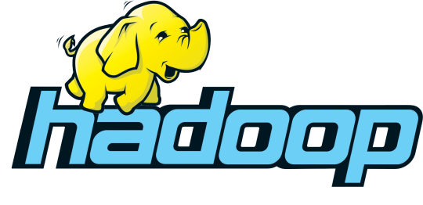

Slide 8
OVERVIEW OF HADOOP CLUSTER
NameNode
Holds the metadata
Secondary NameNode
Performs housekeeping functions for the NameNode
DataNode
Stores the actual HDFS data blocks
JobTracker
Manages MapReduce jobs
TaskTracker
Monitors individual Map and Reduce tasks

Slide 9
NAMENODE
NameNode is the centerpiece of HDFS.
NameNode is also known as the Master
NameNode only stores the metadata of HDFS – the directory tree of all files in the file system, and tracks the files across the cluster.
NameNode does not store the actual data or the dataset. The data itself is actually stored in the DataNodes.
NameNode is so critical to HDFS and when the NameNode is down, HDFS/Hadoop cluster is inaccessible and considered down.
NameNode is a single point of failure in Hadoop cluster.

Slide 10
SECONDARY NAMENODE
It is a backup for the NameNode
Periodically reads the log file and applies the changes to the fsimage file bringing it up to date
Allows the NameNode to restart faster when required
Stores the HDFS file system information in a fsimage
Updates to the file system (add/remove blocks) do not change the fsimage file
They are instead written to a log file
When starting the NameNode loads the fsimage file and then applies the changes in the log file

Slide 11
DATANODE
DataNode is responsible for storing the actual data in HDFS.
DataNode is also known as the Slave
NameNode and DataNode are in constant communication.
When a DataNode starts up it announce itself to the NameNode along with the list of blocks it is responsible for.
When a DataNode is down, it does not affect the availability of data or the cluster. NameNode will arrange for replication for the blocks managed by the DataNode that is not available.

Slide 12
JOBTRACKER AND TASKTRACKER
JobTracker
Determines the execution plan for the job
Assigns individual tasks
TaskTracker
Keeps track of the performance of an individual mapper or reducer

Slide 13
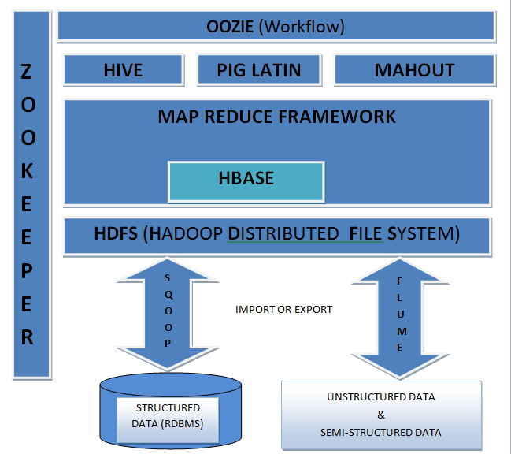
HADOOP ECOSYSTEM

Slide 14
INTRODUCTION OF HADOOP
Open source software framework designed for storage and processing of large scale data on clusters of commodity hardware
Created by Doug Cutting and Mike Carafella in 2005.
Cutting named the program after his son’s toy elephant

Slide 15
TYPES OF DATA
We all know Hadoop is a framework which deals with Big Data but unlike any other frame work it's not a simple framework, it has its own family for processing different thing which is called as Hadoop Ecosystem.
Structured Data - Data which has proper structure and which can be easily stored in tabular form in any relational databases like Mysql, Oracle etc is known as structured data.Example- Employee data .
Semi-Structured Data - Data which has some structure but cannot be saved in a tabular form in relational databases is known as semi structured data. Example-XML data, email messages etc.
Unstructured Data - Data which is not having any structure and cannot be saved in tabular form of relational databases is known as unstructured data. Example- Video files, Audio files, Text file etc.

Slide 16
TOOLS OF HADOOP
HDFS (Hadoop Distributed File System)
MapReduce Framework
Hive
Pig
HBASE
Oozie
Zookeeper

Slide 17
HADOOP DISTRIBUTED FILE SYSTEM(HDFS)
HDFS is a main component of Hadoop and a technique to store the data in distributed manner in order to compute fast.
HDFS saves data in a block of 64MB(default) or 128 MB in size which is logical splitting of data in a Datanode (physical storage of data) in Hadoop cluster(formation of several Datanode which is a collection commodity hardware connected through single network).
All information about data splits in data node known as metadata is captured in Namenode which is again a part of HDFS.
When a client wants to retrieve data Communicates with the NameNode to determine which blocks make up a file and on which data nodes those blocks are stored

Slide 18
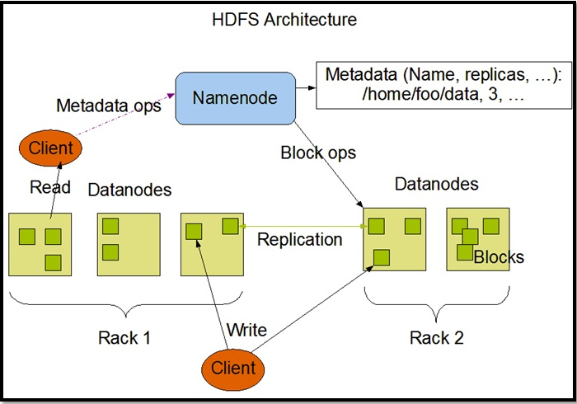
HDFS ARCHITECTURE

Slide 19
MAPREDUCE
It is another main component of Hadoop and a method of programming in a distributed data stored in a HDFS.
We can write Map reduce program by using any language like JAVA, PYTHON, RUBY etc.
By name only Map Reduce gives its functionality Map will do mapping of logic into data (distributed in HDFS) and once computation is over reducer will collect the result of Map to generate final output result of MapReduce. MapReduce Program can be applied to any type of data whether Structured or Unstructured stored in HDFS. Example - word count using MapReduce

Slide 20
MAPPER
Reads data as key/value pairs
The key is often discarded
Outputs zero or more key/value pairs

Slide 21
INPUT SPLITS
Input splits doesn’t contain actual data, rather it has the storage locations to data on HDFS
Usually,Size of Input split is same as block size

Slide 22
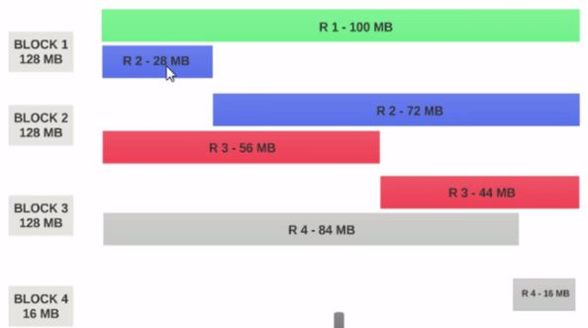
If the HDFS Block Size is configured as 128MB, then the 4 records will not be distributed among the blocks evenly. It will look like this.

Slide 23
SHUFFLE AND SORT
Output from the mapper is sorted by key
All values with the same key are guaranteed to go to the same machine

Slide 24
REDUCER
Called once for each unique key
Gets a list of all values associated with a key as input
The reducer outputs zero or more final key/value pairs

Slide 25
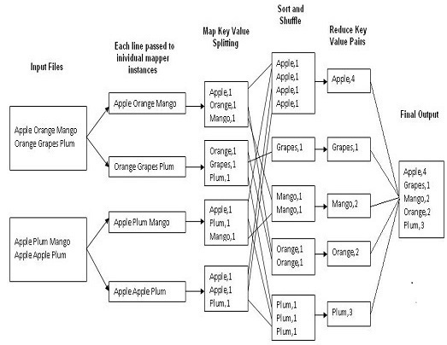
MAPREDUCE: WORD COUNT

Slide 26
HIVE
Many programmers and analyst are more comfortable with Structured Query Language than Java or any other programming language for which Hive is created by Facebook and later donated to Apachefoundation.
Hive mainly deals with structured data which is stored in HDFS with a Query Language similar to SQL and known as HQL (Hive Query Language).
Hive also run Map reduce program in a backend to process data in HDFS but here programmer has not worry about that backend MapReduce job it will look similar to SQL and result will be displayed on console.

Slide 27
PIG
PIG also deals with structured data using PIG LATIN language. PIG was originally developed at Yahoo to answer similar need to HIVE.
It is an alternative provided to programmer who loves scripting and don't want to use Java/Python or SQL to process data.
A Pig Latin program is made up of a series of operations, or transformations, that are applied to the input data which runs MapReduce program in backend to produce output

Slide 28
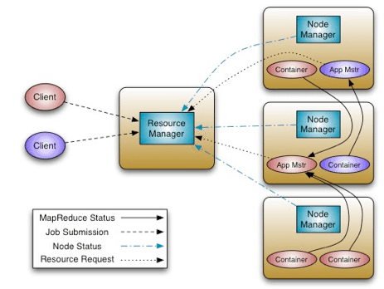
YARN ARCHITECTURE

Slide 29
YARN
The fundamental idea of YARN is to split up the functionalities of resource management and job scheduling/monitoring into separate daemons. The idea is to have a global ResourceManager (RM) and per-application ApplicationMaster (AM). An application is either a single job or a DAG of jobs.
The ResourceManager and the NodeManager form the data-computation framework. The ResourceManager is the ultimate authority that arbitrates resources among all the applications in the system. The NodeManager is the per-machine framework agent who is responsible for containers, monitoring their resource usage (cpu, memory, disk, network) and reporting the same to the ResourceManager/Scheduler.
The per-application ApplicationMaster is, in effect, a framework specific library and is tasked with negotiating resources from the ResourceManager and working with the NodeManager(s) to execute and monitor the tasks.

Slide 30
The Scheduler is responsible for allocating resources to the various running applications subject to familiar constraints of capacities, queues etc. The Scheduler is pure scheduler in the sense that it performs no monitoring or tracking of status for the application. Also, it offers no guarantees about restarting failed tasks either due to application failure or hardware failures.
The ApplicationsManager is responsible for accepting job-submissions, negotiating the first container for executing the application specific ApplicationMaster and provides the service for restarting the ApplicationMaster container on failure. The per-application ApplicationMaster has the responsibility of negotiating appropriate resource containers from the Scheduler, tracking their status and monitoring for progress.

Slide 31
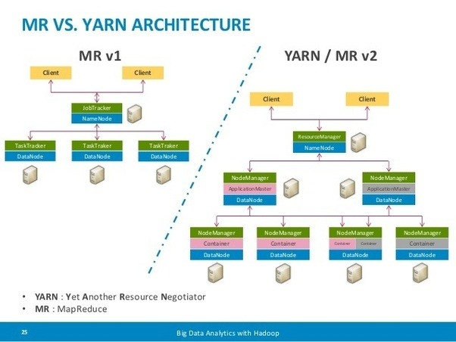
COMPARISON OF HADOOP 1.X AND HADOOP 2.X

Slide 32
FLUME
Flume is a distributed, reliable, and available service for efficiently collecting, aggregating, and moving large amounts of log data.
It has a simple and flexible architecture based on streaming data flows. It is robust and fault tolerant with tunable reliability mechanisms and many failover and recovery mechanisms.
It uses a simple extensible data model that allows for online analytic application.

Slide 33
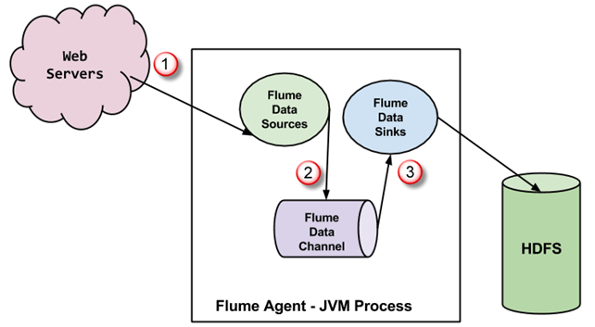
FLUME ARCHITECTURE

Slide 34
HBASE
Hadoop Database or HBASE is a non-relational (NoSQL) database that runs on top of HDFS.
HBASE was created for large table which have billions of rows and millions of columns with fault tolerance capability and horizontal scalability and based on Google Big Table.
Hadoop can perform only batch processing, and data will be accessed only in a sequential manner for random access of huge data HBASE is used.

Slide 35
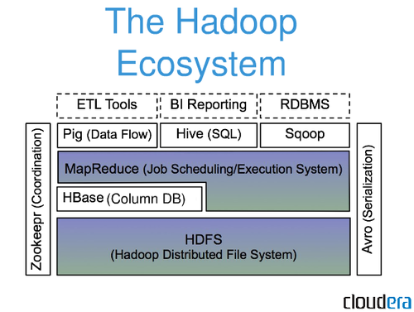
HBASE ARCHITECTURE
HBASE is built On top of HDFS
HBASE files are
Stored internally
In HDFS

Slide 36
OOZIE
It is a workflow scheduler system to manage hadoop jobs.
It is a server-based Workflow Engine specialized in running workflow jobs with actions that run Hadoop MapReduce and Pig jobs.
Oozie is implemented as a Java Web-Application that runs in a Java Servlet-Container.

Slide 37
ZOOKEEPER
Writing distributed applications is difficult because of partial failure may occur between nodes to overcome this Apache Zookeeper has been developed by maintaining an open-source server which enables highly reliable distributed coordination.
ZooKeeper is a centralized service for maintaining configuration information, naming, providing distributed synchronization, and providing group services .
In case of any partial failure clients can connect to any node and be assured that they will receive the correct, up-to-date information.

Slide 38
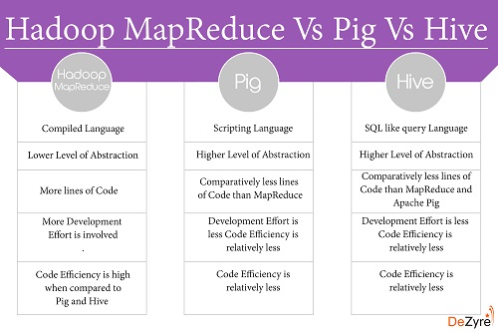
COMPARISON OF HIVE AND PIG AND MAPREDUCE

Slide 39
USES OF HADOOP
Data-intensive text processing
Assembly of large genomes
Graph mining
Machine learning and data mining
Large scale social network analysis

Slide 40
THANK YOU

